Slide 1


Nguyen Yen Sept 7, 2021

Slide 2
Outline
Executive Summary
Introduction
Methodology
Results
Conclusion
Appendix
2

Slide 3
Executive Summary
Beautiful Soup and Python Request libraries were used for data collection
The data was housed on an IBM Cloud DB2 instance for exploratory data analysis, and SQL was used to query the data.
Matplotlib and seaborn were used to create the plots and charts in Python. On folium maps, the geographic data was visualized.
Finally, we used Python's sklearn machine learning framework to create various predictive models.
The Plotly Dash framework was also used to create an interactive dashboard.
After evaluating and comparing the models, the model with the highest accuracy was chosen.
3

Slide 4
Introduction
Due to the recovery of their first stage rockets, Space X is able to execute space flight at a substantially lower cost.
Our firm, Space Y, wants to estimate if Space X will recover the first stage after a launch or not.
If we can anticipate if the first stage will be recovered, we may estimate that the overall cost of the launch will be lower than that of competitors.
As a result, we plan to develop a predictive model to answer the same question and assist us (Space Y) in making a more competitive offer for rocket launches.
4

Slide 5

5

Slide 6
Methodology
Executive Summary
Data collection methodology:
Public available API endpoints from Space X
Perform data wrangling
Looking specifically at Falcon 9
Perform exploratory data analysis (EDA) using visualization and SQL
Perform interactive visual analytics using Folium and Plotly Dash
Perform predictive analysis using classification models
How to build, tune, evaluate classification models

Slide 7
Data Collection
Data was acquired using Space X's publicly accessible API endpoints.
All of the launch details for Falcon rockets were included in the data.
The requests package in Python was used to send GET requests to the endpoints and download data in JSON format, which was then transformed into a Pandas Data Frame.
Web scraping from the wiki website yielded historical records of Falcon 9 launches.
https://api.spacexdata.com/v4

Slide 8
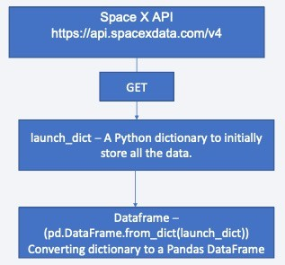
Data Collection – SpaceX API
The launch-related data was obtained via the Space X API.
• The payload, cores, launchpads, and rockets were employed as endpoints.
https://github.com/iamacsimet/Data-Science-Project-about-SpaceX/tree/main/Lab 1

Slide 9
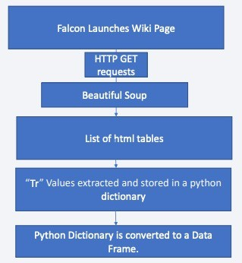
Data Collection - Scraping
We utilized Beautiful soup to web scrape data from html pages into a pandas data frame, and we used Falcon 9 historical launch data from Wikipedia.
https://github.com/iamacsimet/Data-Science-Project-about-SpaceX/tree/main/Web Scrapping Lab

Slide 10
Data Wrangling
We filtered away rows from the primary data frame that only contained Falcon 9 information.
The Payload Mass column had some missing values, which were eliminated and replaced by the column's overall mean.
You need to present your data wrangling process using key phrases and flowcharts
https://github.com/iamacsimet/Data-Science-Project-about-SpaceX/tree/main/Lab 1

Slide 11
EDA with Data Visualization
Several plots were created using Python packages such as matplotlib and seaborn.
The plots were created to visualise and comprehend the many relationships that the data features had with one another; for example, a cat plot was created for the “Flight No. vs. Launch Site” relationship; we also plotted scatter plots, bar charts, and line graphs for the same purpose.
https://github.com/iamacsimet/Data-Science-Project-about-SpaceX/tree/main/Lab 4

Slide 12
EDA with SQL
SQL is a language that may be used to query and manipulate data in a database.
Data from Space X launches was saved on IBM Cloud in a DB2 instance.
We were able to connect to the IBM Cloud hosted database and run SQL queries from Python using sqlalchemy, ibm db sa, and ipython-sql.
https://github.com/iamacsimet/Data-Science-Project-about-SpaceX/tree/main/Lab 3

Slide 13
Build an Interactive Map with Folium
To examine data on the map views, Folium, a python-based framework for creating map visualisations, was utilised.
Because a successful launch is dependent on the position of the launch site and its closeness to other sites such as the sea shore, townships, rivers, and other landmarks, it is critical to select the best launch location. Folium was used to create interactive maps for this reason.
https://github.com/iamacsimet/Data-Science-Project-about-SpaceX/tree/main/Lab 5

Slide 14
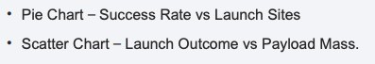
Build a Dashboard with Plotly Dash
Plotly Dash was used to create a small web app (based on the Flask micro framework).
The web app is a straightforward dashboard with two graphs.
We also created a dropdown menu to allow the user to choose which launch location they want to see the statistics for. In the second scatter figure, we also incorporated a slider to select the payload mass range.
https://github.com/iamacsimet/Data-Science-Project-about-SpaceX/blob/f161a4c117d86af21fce2444d2696f22ec94ea9a/application-dash.py
14

Slide 15
Predictive Analysis (Classification)
Based on available input features such as Payload Mass, Flight No, Orbit Type, and so on, predictive models such as logistic regression, KNN, SVM, and Decision Trees were used to create predictions on whether the launch would be successful or not.
The input data was divided into two sets: training and test. The training set was used to create the models, while the test sets were used to assess the models' accuracy.
We determined which model worked better based on the accuracy results. The Grid Search method was also used to determine the hyper parameters of each model.
https://github.com/iamacsimet/Data-Science-Project-about-SpaceX/tree/main/Lab 6

Slide 16
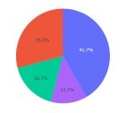
Results
A variety of data plots and map visualizations were provided in our EDA.
We were able to see connections between distinct input features and the consequences that resulted from them.
Scatter plots such as Flight No. vs. Outcome revealed that the outcome of a launch was largely influenced by payload tonnage and the orbit chosen for the launch.
Using Folium, we visualized where successful launches occurred and where unsuccessful launches occurred. We also had to calculate the distances between the launch zones and nearby town ships or coasts.
Interactive analytics demo in screenshots
Predictive analysis results

Slide 17


Slide 18
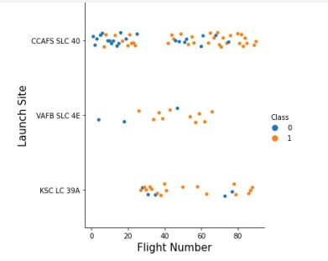
Flight Number vs. Launch Site
According to the graph, the launch site CCAFS SLC 40 has more launches than any other launch site; however, the flight number does not appear to have a clear association with the flight's outcome. The same can be stated for the launch site, but when compared to CCAFS SLC 40, we can observe that KSC LC 39 A and VAFB SLC 4E have a lower failure rate.

Slide 19
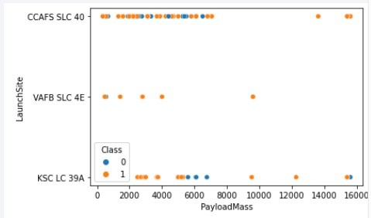
Payload vs. Launch Site
The payload varies from 0 kg to16000 kg
From KSC LC 39, the launches must have a payload of at least 2000 kilos
Launches with a larger payload greater than 8000 kg appears to have a positive consequence
CCAFS SLC 40 is the one with the most Payloads vary depending on the launch. between 1000 and ten thousand kilograms

Slide 20
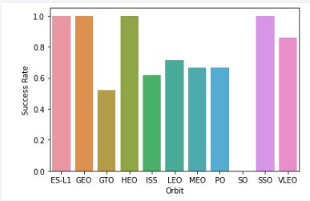
Success Rate vs. Orbit Type
The Orbit and the Success Rate
• As can be seen, GTO has the lowest success rate, while ES-L1, GEO, HEO, and SSO have the best success rates.

Slide 21
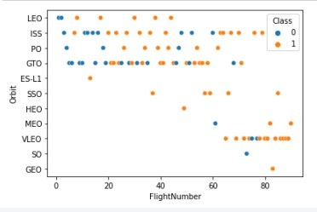
Flight Number vs. Orbit Type
Scatter plot for Orbit Type vs. Flight.
In LEO orbit, success appears to be connected to the number of flights; however, in GTO orbit, there appears to be no relationship between flight number and success.

Slide 22
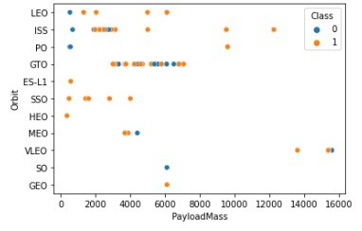
Payload vs. Orbit Type
Payload Mass vs Orbit type scatter plot
Heavy payloads have a detrimental impact on GTO orbits but a favourable impact on GTO and Polar LEO (ISS) orbits.

Slide 23
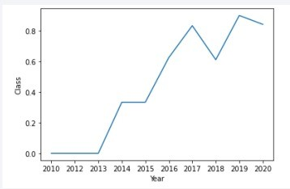
Launch Success Yearly Trend
Trend for success vs year
Rate has significantly increased post 2013 to 2020

Slide 24
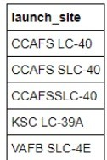

All Launch Site Names
Unique launch sites:
Query:

Slide 25
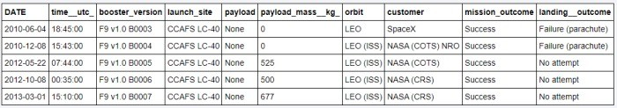
Launch Site Names Begin with 'CCA'
Query:
Results:

Slide 26
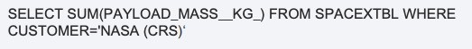
Total Payload Mass
Total payload mass: 45,596 KG
Query:

Slide 27
Average Payload Mass by F9 v1.1
Result: 2534 KG
Query Used

Slide 28
First Successful Ground Landing Date
Result: December 22, 2015
Query Used

Slide 29
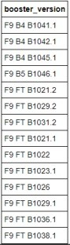
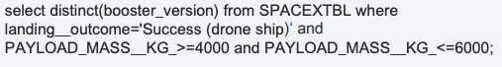
Successful Drone Ship Landing with Payload between 4000 and 6000
List the names of boosters which have successfully landed on drone ship and had payload mass greater than 4000 but less than 6000:
Query Used: (results to the right)

Slide 30
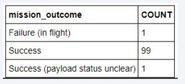
Total Number of Successful and Failure Mission Outcomes
Successful and failure outcomes:
Query Used:

Slide 31
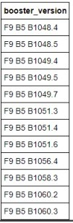
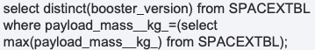
Boosters Carried Maximum Payload
List the names of the booster which have carried the maximum payload mass
Query Used:

Slide 32
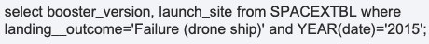
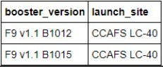
2015 Launch Records
List the failed landingoutcomes in drone ship, their booster versions, and launch site names for in year 2015
Query Used:
Results

Slide 33
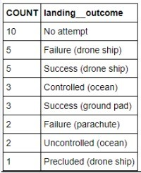
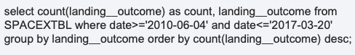
Rank Landing Outcomes Between 2010-06-04 and 2017-03-20
Rank the count of landing outcomes (such as Failure (drone ship) or Success (ground pad)) between the date 2010-06-04 and 2017-03-20, in descending order
Query Used:
Results on right

Slide 34


Slide 35
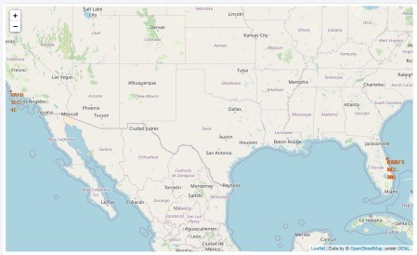

Site for Launch Locations
The following map depicts the many launch sites as well as the NASA JSC.
They're all marked on a typical map of the United States.
Majority of the launch points are along the water's edge - One is in the Los Angeles area, and the others are in Florida.

Slide 36
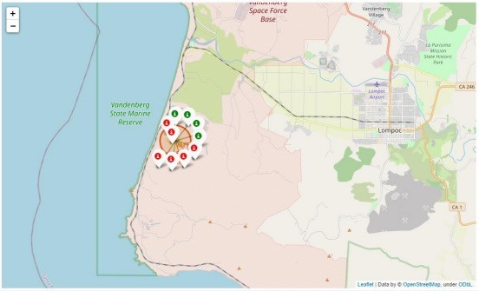
Success and Failures for launches at sites
We put markers to the map below to show the launch results for each launch point.
We were able to identify and pinpoint which launch sites had the most successful launches using the map.

Slide 37
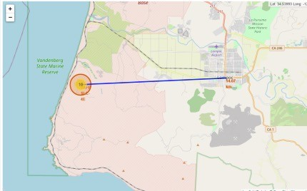
Launch Site Distances
We can also create polygons, lines, and other geometries on the map using folium.
Calculated the distance between two points and then drew a line between them.
As can be seen on the map below, there is an airport (Lompoc Airport) within 14.07 KM of the launch location
– VAFE SLC 4E.

Slide 38


Slide 39
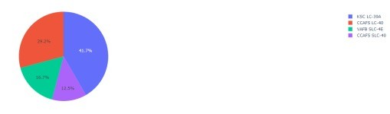
Launch Sites Success Rates
Shows success percent for launch sites
KSC LC 39-A has highest success rate
CCAFS SLC 40 has lowest success rate

Slide 40
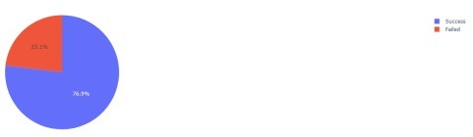
In Depth: KSC LC 39-A
Chart for KSC LC 39-A through Plotly dashboard
Success rate of 77%
Failure rate of 23%

Slide 41
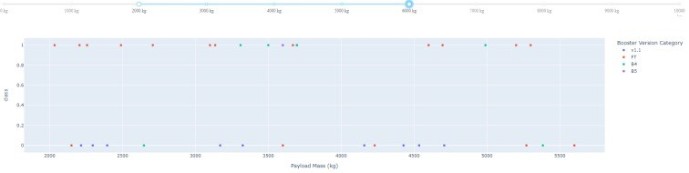
Launch vs Payload: Outcomes
The link between launch outcomes and payload mass is depicted in the scatter plot below. We have a payload mass range slider that allows us to filter a payload mass range for the scatter plot. We've chosen a weight range of 2000kg to 6000kg.
The points are color-coded according to the booster version that was utilised.
We can observe that many of the v1.1 boosters failed to launch, but FT boosters appear to be more successful than the rest.

Slide 42


Slide 43
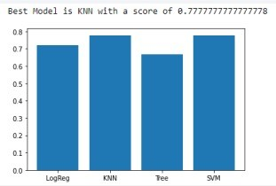
Classification Accuracy
Models were trained and tested on same dataset
KNN performed best
Max Accuracy we could get was 77%

Slide 44
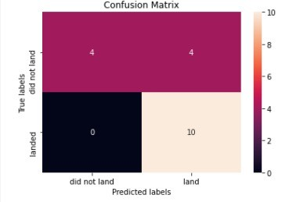
Confusion Matrix
Confusion matrix made for KNN model
Model could predict all 10 correctly of the 10 flights that were successful
Of the 8 unsuccessful flights, 4 were predicted correctly

Slide 45
Conclusions
With the help of many input data and attributes provided by Space X Falcon 9 flights, we attempted to construct a prediction model.
The KNN models were chosen as the best model for the given data set and input attributes after a comparison of other machine learning models.
We may be able to enhance the model's accuracy in the future by giving more data or using other machine learning approaches such as neural networks; nonetheless, we were able to evaluate and understand the data and display it in a well-structured manner using dashboards and charts.
Before moving on to creating predictive models, these are required for any data science endeavor.

Slide 46


